Slide 1

Online Shopping System Website (OSSW)
Students Preparation:
Kawther Al Maharmeh
Marah alhrob

Slide 2
The content
1.1 problem statement ………………………………………………………………………..
1.2 Solving statement…………………………………………………………………………
2.1 Use-case modeling …………………………………………………………………………
2.2 use case description ………………………………………………………………………
2.3 Scenario……………………………………………………………………………………
2.4 Sequence diagram ……………………………………………………………………......
2.5 activity diagram …………………………………………………………………………….
2.6 state chart diagram ……………………………………………………………………….

Slide 3
Problem statement
Sometimes, it may be business owners' idea to go online stores due to higher rental rates or lower tax rates. But in common cases, some people find it difficult to go to the market. Some of them do not have time, or do not know how much money they need, or because they do not have enough energy.

Slide 4
Solving statement
Creating an online shopping system to help people shop, know prices, and pay online, which reduces time, effort, and fraud by manipulating prices.

Slide 5
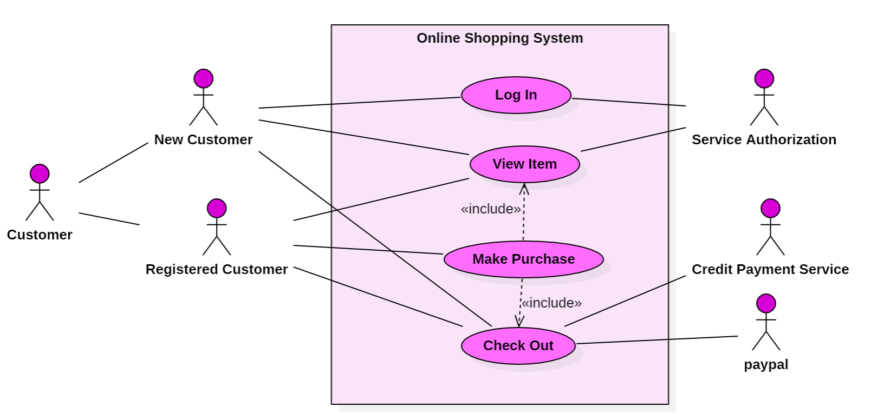
Use-Case Modeling

Slide 6
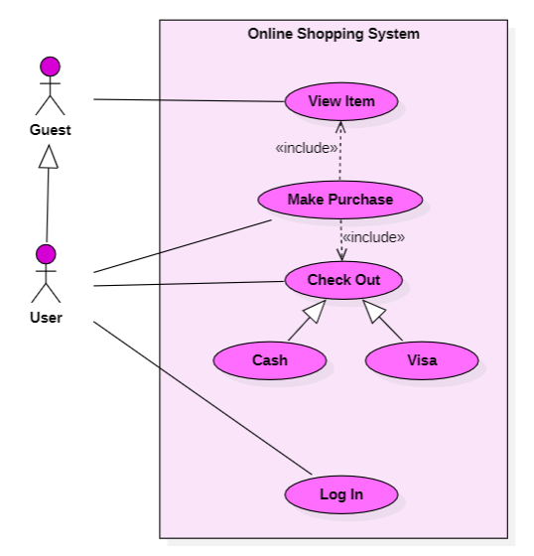
Use-Case Modeling
Actor ممثل الأشخاص الذين يتفاعلون مع النظام
Use case وظيفة
علاقة (include) هي تبين وظيفة يجب ان تحدث حتى تحدث الوظيفة الأخرى
علاقة (Generalization) هي علاقة الوراثة مثلا(المستخدم يرث وظائف الضيف "يعني بقومو فيهم")
علاقة (Association) هي تبين الوظائف التي يقوم بها الactor

Slide 7
Use-Case Description
Online Shopping System | Use case name
Initiated by Customer Communicates with service authorization | Participating actors
The Customer is logged into website | Entry condition
The Customer sign in to website if he has an account The Customer login to website if he doesn’t have account The website respond by presenting form to the Customer The website display the home page where the Customer can view the products The Customer can be able to see the quantities color and size The service authorization allow the Customer to give permissions | Flow of events
The website display notification if the product is not available | Exit condition
The website verification Log In with 10s | Quality requirements

Slide 8
Use-Case Description
View Item | Use case name
Guest, User | Participating actors
The user or guest opened the website | Entry condition
The user or guest opened the site The site displays the existing items The user browses these items and views their prices | Flow of events
The website display notification if the product is not available | Exit condition
Display items for a maximum period of 10 seconds | Quality requirements

Slide 9
Use-Case Description
Make Purchase | Use case name
User | Participating actors
The User is logged into website | Entry condition
The site displays the existing items The user browses these items and views their prices The user chooses the item he wants to purchase Specifies the payment method: Cash or Visa The purchase order is sent to the officials to secure it | Flow of events
Finish selecting the order and paying | Exit condition
Make the payment process in a safe and fast way | Quality requirements

Slide 10
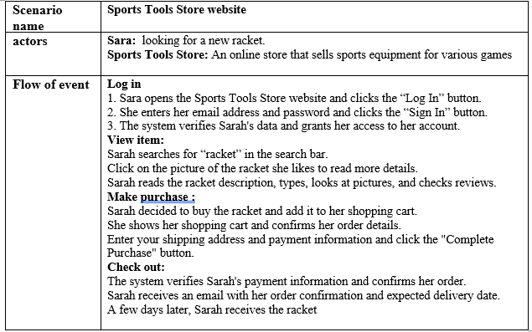
scenarios

Slide 11
scenarios
Sports Tools Store website | Scenario name
Sara: looking for a new racket. Sports Tools Store: An online store that sells sports equipment for various games | actors
Log in Sara opens the Sports Tools Store website and clicks the “Log In” button. She enters her email address and password and clicks the “Sign In” button. The system verifies Sarah's data and grants her access to her account. View item: Sarah searches for “racket” in the search bar. Click on the picture of the racket she likes to read more details. Sarah reads the racket description, types, looks at pictures, and checks reviews. Make purchase : Sarah decided to buy the racket and add it to her shopping cart. She shows her shopping cart and confirms her order details. Enter your shipping address and payment information and click the "Complete Purchase" button. Check out: The system verifies Sarah's payment information and confirms her order. Sarah receives an email with her order confirmation and expected delivery date. A few days later, Sarah receives the racket | Flow of events

Slide 12
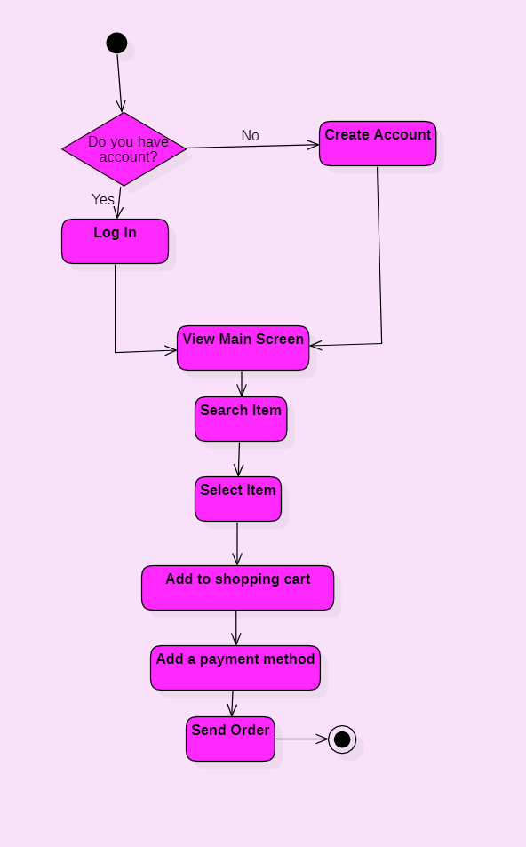
Activity Diagram
Initial
البداية
Control Flow
التحكم في التدفق
Decision
قرار
Action
فعل
Final
النهاية

Slide 13
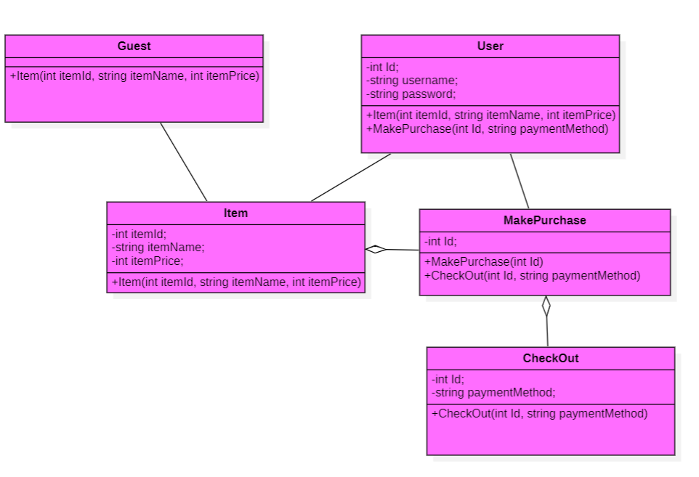
Class Diagram
اسم الClass
خصائص أو سلوكيات Attribute
علاقة Aggregation
علاقة Aggregation
هي علاقة اذا تم فقد المالك (owner) يتم فقدها
مهام أو وظائف Operation

Slide 14
The End

